Slide 1
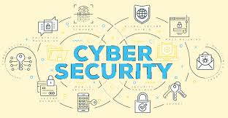

CA 501 : CYBER SECURITY
Chapter 5 - Cyber Forensics

Slide 2

Let’s Start
Topics:
5.1 Introduction
5.2 Historical background of Cyber forensics
5.3 Digital Forensics Science
5.4 The Need for Computer Forensics
5.5 Cyber Forensics and Digital evidence
5.6 Forensics Analysis of Email
5.7 Digital Forensics Lifecycle
5.8 Challenges in Computer Forensics

Slide 3
Introduction
- Cyber forensics involves the investigation of computer-related crimes with the goal of obtaining evidence to be presented in a court of law.
- With the current upsurge in the use of digital devices for both commercial and private activities, relevant evidence are often found on suspect(s) devices during investigations. Specialized skills are required to identify, collect, preserve, examine, analyze and present these evidence in a way that is legally admissible.
- A suspect’s digital device may contain relevant evidence such as visited websites, installed applications, documents created, media files, and network activities, plan of criminal activities or stolen data. This could be invaluable in a criminal or civil investigation.
FORENSIC SCIENCE
DIGITAL FORENSIC SCIENCE
CYBER/ COMPUTER FORENSIC

Slide 4
Introduction
- The process of gathering and documenting proof from a computer or a computing device in a form presentable to the court by applying the techniques of investigation and analysis is called Cyber Forensics. Cyber Forensics is also called Computer Forensics.
- It is a branch of digital forensic science pertaining to evidence found in computers and digital storage media. The goal of computer forensics is to examine digital media in a forensically sound manner with the aim of identifying, preserving, recovering, analyzing and presenting facts and opinions about the digital information.
- It determines who is responsible for what exactly happened on the computer while documenting the evidence and performing a proper investigation. The storage media of the device under investigation is made into a digital copy by the investigators and the investigation is performed on the digital copy while making sure the device under investigation is not contaminated accidentally.

Slide 5
Introduction
- Computer forensics is the application of investigation and analysis techniques to gather and preserve evidence from a particular computing device in a way that is suitable for presentation in a court of law.
- The goal of computer forensics is to perform a structured investigation and maintain a documented chain of evidence to find out exactly what happened on a computing device and who was responsible for it. It is a data recovery with legal compliance guidelines to make the information admissible in legal proceedings.
- Digital forensics starts with the collection of information in a way that maintains its integrity. Investigators then analyze the data or system to determine if it was changed, how it was changed and who made the changes. The use of computer forensics isn't always tied to a crime.
- The forensic process is also used as part of data recovery processes to gather data from a crashed server, failed drive, reformatted operating system (OS) or other situation where a system has unexpectedly stopped working.

Slide 6
Historical Background of Cyber Forensics
- In the early 1980s personal computers became more accessible to consumers, leading to their increased use in criminal activity (for example, to help commit fraud). At the same time, several new "computer crimes" were recognized (such as cracking). The discipline of computer forensics emerged during this time as a method to recover and investigate digital evidence for use in court.
- Until the late 1990s, what became known as digital forensics was commonly termed computer forensics. The first computer forensic technicians were law enforcement officers who were also computer hobbyists. In the USA in 1984 work began in the FBI Computer Analysis and Response Team (CART). One year later, in the UK, the Metropolitan Police set up a computer crime unit called as Fraud Squad.
- Since then computer crime and computer related crime has grown, and has jumped 67% between 2002 and 2003. Today it is used to investigate a wide variety of crime, including child pornography, fraud, espionage, cyber stalking, murder and rape.

Slide 7
Historical Background of Cyber Forensics
- Forensic techniques and expert knowledge are used to explain the current state of a digital artifact, such as a computer system, storage medium (e.g. hard disk or CD-ROM), or an electronic document (e.g. an email message or JPEG image). The scope of a forensic analysis can vary from simple information retrieval to reconstructing a series of events.
- The computer forensic field continues to grow on a daily basis. Over the next decades, and up to today, the field has exploded. Law enforcement and the military continue to have a large presence in the information security and computer forensic field at the local, state, and federal level.

Slide 8
Digital Forensics Science
- Digital forensics (sometimes known as digital forensic science) is a branch of forensic science encompassing the recovery, investigation, examination and analysis of material found in digital devices, often in relation to mobile devices and computer crime. The term digital forensics was originally used as a synonym for computer forensics but has expanded to cover investigation of all devices capable of storing digital data.
- With roots in the personal computing revolution of the late 1970s and early 1980s, the discipline evolved in a haphazard manner during the 1990s, and it was not until the early 21st century that national policies emerged.
- Although the first computer crime was reported in 1978, followed by the Florida computers act, it wasn’t until the 1990s that it became a recognized term.

Slide 9
Digital Forensics Science
- Digital forensics is the process of uncovering and interpreting electronic data. The goal of the process is to preserve any evidence in its most original form while performing a structured investigation by collecting, identifying, and validating the digital information to reconstruct past events.
- The context is most often for the usage of data in a court of law, though digital forensics can be used in other instances.
- It is the process of identifying, preserving, analyzing, and documenting digital evidence. This is done in order to present evidence in a court of law when required.

Slide 10
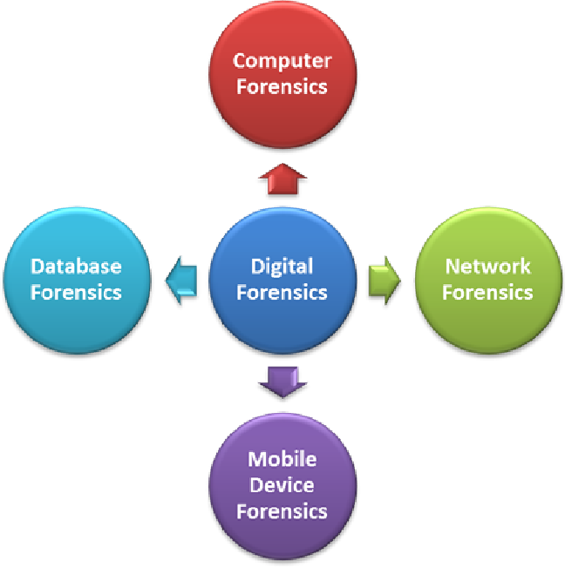
Digital Forensics Science
- Types

Slide 11
Digital Forensics Science
Advantages of Digital forensics:
To ensure the integrity of the computer system
To produce evidence in the court, this can lead to the punishment of the culprit
It helps the companies to capture important information if their computer systems or networks are compromised.
Efficiently tracks down cybercriminals from anywhere in the world
Helps to protect the organization’s money and valuable time
Allows extracting, process, and interpreting the factual evidence, so it proves the cybercriminal action’s in the court

Slide 12
Digital Forensics Science
Disadvantages of Digital Forensics:
Digital evidence accepted into court. However, it is must be proved that there is no tampering
Producing electronic records and storing them is an extremely costly affair
Legal practitioners must have extensive computer knowledge
Need to produce authentic and convincing evidence
If the tool used for digital forensic is not according to specified standards, then in the court of law, the evidence can be disapproved by justice.
Lack of technical knowledge by the investigating officer might not offer the desired result

Slide 13
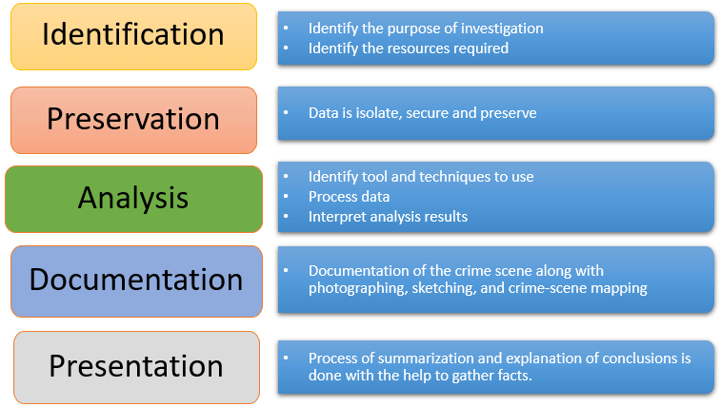
Digital Forensics Lifecycle
-

Slide 14
Digital Forensics Lifecycle
1. Identification:
It is the first step in the forensic process. The identification process mainly includes things like what evidence is present, where it is stored, and lastly, how it is stored (in which format). It includes of identifying evidences related to the digital crime in storage media, hardware, operating system, network and/or applications.
Electronic storage media can be personal computers, Mobile phones, PDAs, etc.
2) Preservation:
In this phase, data is isolated, secured, and preserved. It includes preventing people from using the digital device so that digital evidence is not tampered with.

Slide 15
Digital Forensics Lifecycle
3. Analysis:
In this step, investigation agents reconstruct fragments of data and draw conclusions based on evidence found. However, it might take numerous iterations of examination to support a specific crime theory. It includes analyzing the collected digital evidences of the committed computer crime in order to trace the criminal and possible path used to breach into the system.
4. Documentation:
In this process, a record of all the visible data must be created. It includes the proper documentation of the whole digital investigation, digital evidences, loop holes of the attacked system etc. so that the case can be studied and analyzed in future also and can be presented in the court in a proper format. It helps in recreating the crime scene and reviewing it. It involves proper documentation of the crime scene along with photographing, sketching, and crime-scene mapping.

Slide 16
Digital Forensics Lifecycle
5. Presentation:
In this last step, the process of summarization and explanation of conclusions is done.
It includes the presentation of all the digital evidences and documentation in the court in order to prove the digital crime committed and identify the criminal.

Slide 17
Digital Forensics Cases
1. Dennis Rader (2005):
The famous “BTK” Serial Killer was on the run for more than 30 years, and after years he re-emerged and took another victim in Kansas following which he sent a floppy disk to the police with a letter on it. Upon forensic investigation, the investigators found a deleted Microsoft Word file. The metadata recovered showed that the last person to edit the file was authored by “Dennis” along with a link to the Lutheran Church. Ironically, Rader had sent a floppy disk to the police because the police had previously told him that letters on floppy disks could not be traced.

Slide 18
Need for Cyber Forensics
- The need for cyber forensics is simple yet of utmost importance. Cyber Forensics is needed for the investigation of crime and law enforcement. There are cases like hacking and denial of service (DOS) attacks where the computer system is the crime scene. The proof of the crime will be present in the computer system.
- The proofs can be browsing history, emails, documents, etc. These proofs on the computer system alone can be used as evidence in the court of law to sort out allegations or to protect the innocent people from charges.
- It is needed that they survey a crime scene that is associated with any digital evidence. It searches and identifies data that is related to cybercrime in any digital asset.
- Cyber forensics can also help in recovering encrypted, deleted, or corrupted files. Digital evidence can be easily destroyed if not handled properly. Cyber Forensic Investigators should be competent in handling that digital evidence.

Slide 19
Need for Cyber Forensics
Primary objectives:
1. For recovering, analyzing, reporting, and presenting computer-oriented materials so that it can be easily demonstrated and presented in the form of evidence in the court of law.
2. To identify evidence in a short time frame, and estimate the overall threat and impact of the malicious cyber activity on the victim user or organization and suggest for protection against the attack.

Slide 20
Cases of Cyber Forensics
Hosting Obscene Profiles (Tamil Nadu)
The case is about the hosting obscene profiles. This case has solved by the investigation team in Tamil Nadu. The complainant was a girl and the suspect was her college mate. In this case the suspect will create some fake profile of the complainant and put in some dating website. He did this as a revenge for not accepting his marriage proposal.
The suspect was convicted of the crime, and he sentenced to two years of imprisonment as well as fine.
Illegal money transfer (Maharashtra)
The second case is about an illegal money transfer. This case is happened in Maharashtra. The accused in this case is a person who is worked in a BPO. He is handling the business of a multinational bank. So, he had used some confidential information of the banks customers and transferred huge sum of money from the accounts.

Slide 21
Cases of Cyber Forensics
As per the complaint received from the firm they analyzed and studied the systems of the firm to determine the source of data theft. During the investigation the system server logs of BPO were collected, and they find that the illegal transfer were made by tracing the IP address to the internet service provider and it is ultimately through cyber café. The registers made in cyber café assisted in identifying the accused in the case. Almost 17 accused were arrested. Trail for this case is not completed, its pending trial in the court.

Slide 22
Cyber Forensics and Digital evidence
- The criminals are using various high end technologies to commit such crimes which are beyond the reach and understanding of a layman. A person unskilled in this cannot fancy tracing the roots of the crime.
- Digital evidence, also commonly known as electronic evidence, is data stored within electronic devices or systems that can be recovered by forensic experts and used as admissible evidence in court.
- With the prolific usage of electronic devices such as smartphones and computers, the amount of data generated from these devices is vast. As such, there can be an expectation within almost any investigation for the need to identify digital evidence. If identified, collected and analyzed in a forensically sound manner, digital evidence can prove crucial to the outcome of criminal, civil and corporate investigations.
- Data recovered from the following devices and applications are considered as evidence. However, this is only admissible if recovered using a forensic methodology by a certified expert.

Slide 23
Cyber Forensics and Digital evidence
- Data recovered from the following devices and applications are considered as evidence. However, this is only admissible if recovered using a forensic methodology by a certified expert.
1. Computers, laptops and tablets
2. Mobile phone data
3. HDD, RAID and SSD hard drives
4. USB memory sticks and SD cards
5. Social media information
6. WhatsApp messages
7. Cloud storage data
8. Digital photographs
9. CCTV

Slide 24
Forensic Analysis of Email
- Email is one of the most popular services used over the internet and has become a primary source of communication for organizations and the public. Usage of email services in business activities like banking, messaging and sending file attachments increased at a tremendous rate.
- This medium for communication has become vulnerable to different kinds of attacks. Hackers can forge the email headers and send the email anonymously for their malicious purposes. Hackers can also exploit open relay servers to carry out massive social engineering. Email is the most common source of phishing attacks.
- Email forensics is the study of source and content of email as evidence to identify the actual sender and recipient of a message along with some other information such as date/time of transmission and intention of sender.
- It involves investigating metadata, port scanning as well as keyword searching. Email forensics also reforms to the forensics of client or server systems suspected in an email forgery.

Slide 25
Forensic Analysis of Email
- To mitigate these attacks and catch the people responsible, we use email forensics and techniques.
Some of the common techniques which can be used for email forensic investigation are
Header Analysis
Server investigation
Network Device Investigation
Sender Mailer Fingerprints
Software Embedded Identifiers
Email Architecture:
When a user sends an email, the email doesn’t go directly into the mail server at the recipient’s end; rather, it passes through different mail servers.

Slide 26
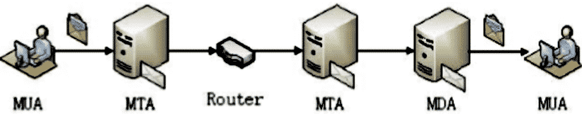
Forensic Analysis of Email
- Email forensics starts with the study of email header as it contains a vast amount of information about the email message. This analysis consists of both the study of the content body and the email header containing the info about the given email. Email header analysis helps in identifying most of the email related crimes like spear phishing, spamming, email spoofing etc. Spoofing is a technique using which one can pretend to be someone else, and a normal user would think for a moment that it’s his friend or some person he already knows. It’s just that someone is sending emails from their friend’s spoofed email address, and it is not that their account is hacked.

Slide 27
Challenges in Computer Forensics
Here, are major challenges faced by the Digital Forensic:
- The increase of PC’s and extensive use of internet access
- Easy availability of hacking tools
- Lack of physical evidence makes prosecution difficult.
- The large amount of storage space into Terabytes that makes this investigation job difficult
- Any technological changes require an upgrade or changes to solutions.
- Evidence is no longer confined within a single place but, rather, is scattered among different physical or virtual locations, such as online social networks, cloud resources, and personal network–attached storage units.
- Nowadays, people bring into cyberspace many aspects of their lives, primarily through online social networks or social media sites. Unfortunately, collecting information to reconstruct and locate an attack can severely violate users’ privacy and is linked to other hurdles when cloud computing is involved.

Slide 28
Challenges in Computer Forensics
- Cyber forensics is a branch of forensic science which deals with the investigation, analysis techniques on computers.
- Cyber Forensic is also referred as Computer Forensic as it includes computer system indulged in Cyber Crime.
- Cyber Forensic aids in an investigation, collection and preservation of Evidences for legal purposes.

Slide 29


